Slide 1
Machine Learning and AI
AI Module 6.5 – Transfer Learning

Slide 2
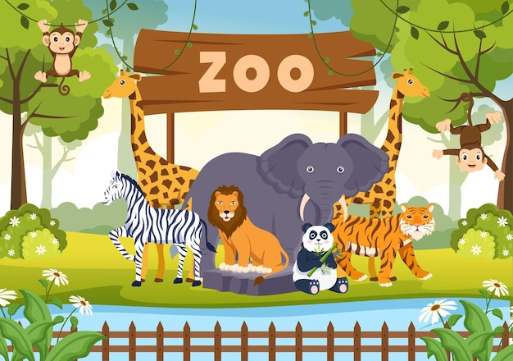
Re-using Trained Models
For many common problems, you can import pre-trained models and just use them.
Image classification (ResNet, Inception, MobileNet, Oxford VGG).
NLP (word2vec,GloVE)
Use them as-is, or tune them for your application
Model Zoos
Caffe Model Zoo
Class Walkthrough open the Jupyter Notbook:
TransferLearning.ipynb
Notes:
The idea here is to use pre-trained models already
that are out there available
on the internet for anyone to use,
and for a lot of common problems you can just
import a pre-trained model that somebody else did
all the hard work of putting together
and optimizing and figuring out the right parameters
and the right topology and just use them.
So for example if you're trying to do image classification
there are pre-trained models out there that you
can just import.
Some of them are called ResNet,
Inception MobileNet and Oxford VGG are some examples.
And they come pre-trained
with a very wide variety of object types.
So in many cases you can just unleash one
of these off the shelf models point a camera
at something and it will tell you what it is.
That's kind of freaky.
Similarly for natural language processing
there are pre-trained models available as well,
such as word2vec and GloVe that you can use to
basically teach your computer how to read
with just a few lines of code.
Now you can just use them as is
but you can also just use them
as a starting point if you wanna extend
on them or build on them for more specific problems.
So even if they don't solve the specific problem
you're trying to solve
you can still use these pre-trained models
as a starting point.
To build off of that is,
you know a lot easier to get going with.
You don't have to waste a lot
of time trying to figure out the right topology
and parameters for a specific kind of problem.
You can start with a model that's already figured all that
out for you and just add on top of it.
This is called transfer learning.
Basically we're transferring an existing trained model
from somebody else to your application.
Now you can find more
of these pre-trained models and what are called model zoos.
A popular one is called the Caffe Model Zoo, and it's
I'm not sure what to think of all this.
I mean it is super super easy to deploy AI
now as you'll soon see in our next example
you can just import an existing model zoo model
and start using it with just you know
four or five lines of code.
You don't have to really be a very good developer
anymore to actually use AI for practical applications.
So kind of kind of a weird place
for the industry to be right now and kind of opens
up a lot of interesting and potentially scary possibilities
of how people might start to use this technology
when there's such a low barrier
to entry now of actually using it.
Anyway let's dive into a real world example
and I'll show you just how scary easy it is now.

